Slide 1
Movie Watching site
BY-
Manav(22-cse-076)
Manjeet(22-cse-078)
Manjeet(22-cse-077)
Lokesh prasad prajapati(22-cse-073)

Slide 2
MovieSafari.com
Moviesfari.com is an online platform where users can watch movies, series, anime etc.
It includes variety of content such as horror, thriller ,drama, sci-fi, etc.
It offers subscription for months and year which include no-ads, premium content, etc.

Slide 3
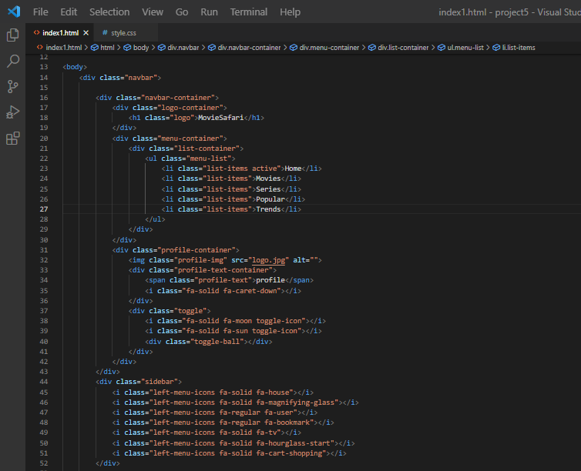
Html Content

Slide 4
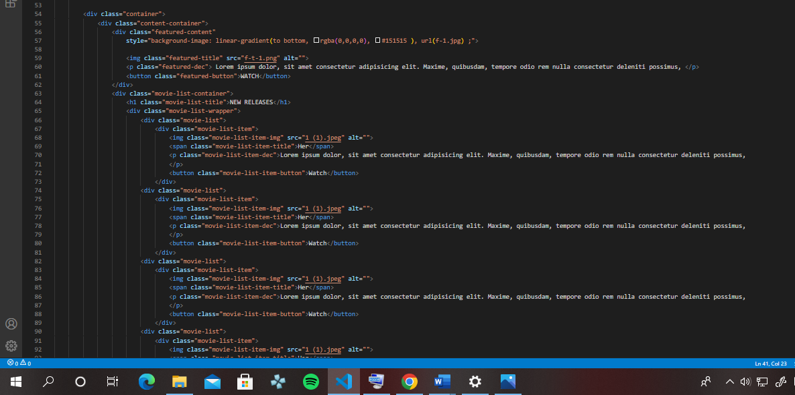
Html Content

Slide 5
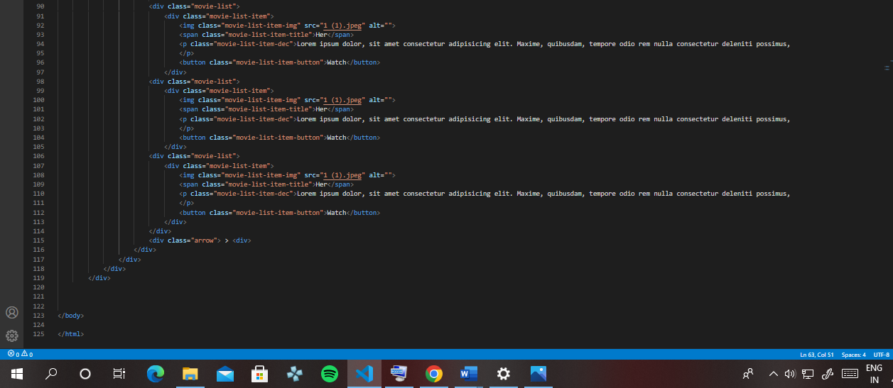
Html Content

Slide 6
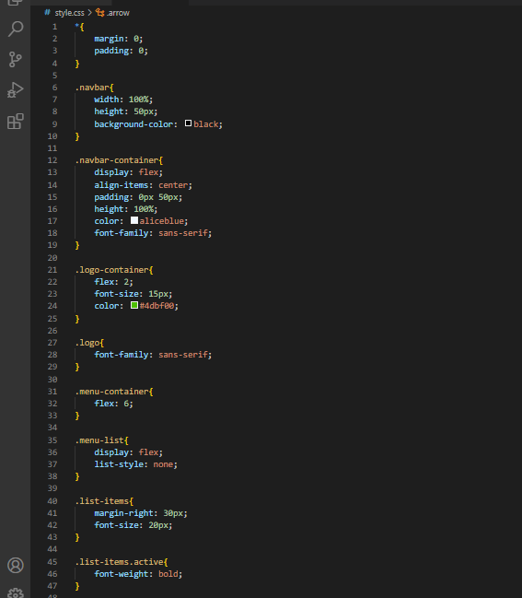
CSS Content

Slide 7
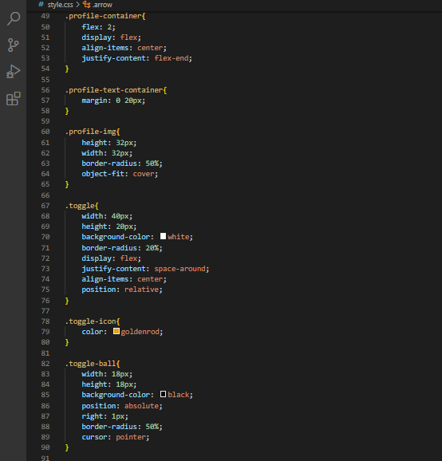
CSS Content

Slide 8
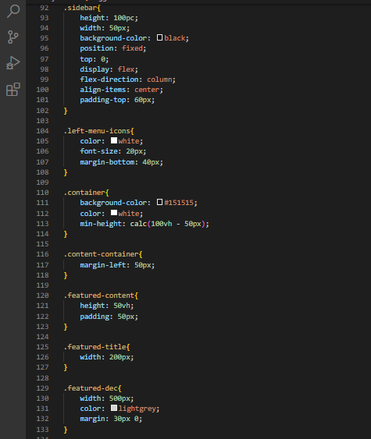
CSS Content

Slide 9
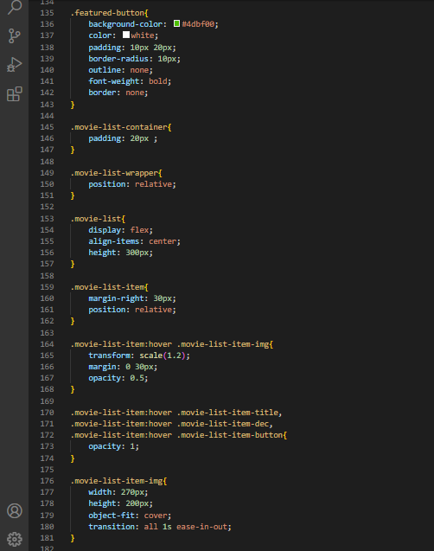
CSS Content

Slide 10
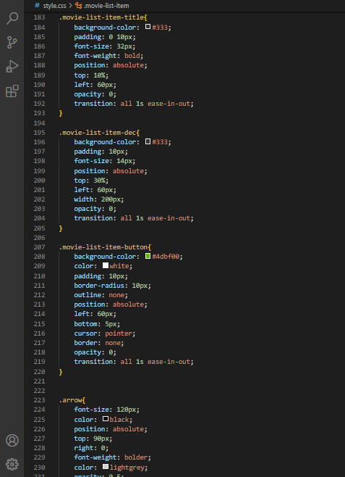
CSS Content

Slide 11

OUTPUT

Slide 12
Thank You

